Slide 1


Real Estate Sales 2001-2020
DS 5220: Supervised Machine Learning and Learning Theory
By: Ikonkar Kaur Khalsa & Matthew Gregorio

Slide 2

Introduction
Objectives and Goals
Primary Objective: Develop machine learning models for accurate and interpretable predictions of house sale amounts and affordability classification.
Target Outcomes: Select the best predictive model for both continuous sale amounts and binary affordability classification
Background Information
Dataset Source: Kaggle
Dataset Characteristics: Over 1 million transactions spanning two decades of real estate data
Machine Learning Approaches:
Regression Models: Linear, Lasso, Ridge
Classification Models: Logistics Regression, Decision Trees, Gaussian Naive Bayes, Neural Networks (attempted SVM, Random Forest Classifier, and KNN)

Slide 3

Literature Review
Article 1: Selecting Machine Learning Algorithms Using Regression
Focus: Optimizes model selection using meta-learning
Method: Uses statistical features, regression trees, and hyperparameter tuning
Findings: Reduces computational complexity; improves model selection accuracy
Gap: Requires a minimum of 4 features per dataset
Article 2: Comparison of Machine Learning Algorithms in Data Classification
Focus: Evaluates 6 classifiers for binary outcomes
Method: Data from UCI, preprocessing, training, and evaluation
Findings: Random Forest is the most effective model
Gap: Limited dataset size; no hyperparameter tuning
Project Relation to Research
Inspired by Meta-Learning: Streamlines model selection using robust feature extraction and selection
Classifier Comparison: Evaluates multiple classification algorithms for affordability prediction and regression models for sale amount prediction
Addressing Gaps: Uses a large dataset and incorporates hyperparameter tuning for optimal performance

Slide 4
Methodology - Steps Of This Project
Data Collection
Exploratory Data Analysis
Classification Analysis
Data Preprocessing
Regression Analysis

Slide 5
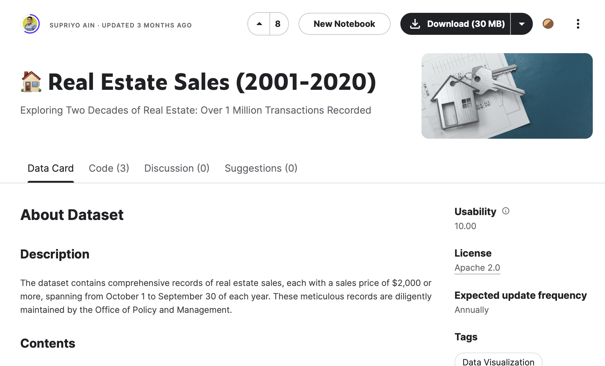
Methodology - Data Collection
Source
Kaggle
Reason for Selection
Extensive, mostly clean, and complete data.
Dataset Characteristics
Contains over 1 million transactions.
Spans two decades of real estate data.

Slide 6
Methodology - Data Preprocessing
Original Dataset (11 features)
Data Recorded, List Year, Town, Address, Sale Amount, Sales Ratio, Property Type, Residential Type, Longitude, Latitude.
Initial Rows: 1,054,159
Duplicate Removal
Dropped 8,705 duplicate entries!
Rows After Removal: 1,045,454
Label Encoding
Categorical features: Date Recorded, Town, Address, Property Type, Residential Type
Encoded to numerical using one-hot encoding
Resulting features: “date_n”, “town_n”, “address_n”, “property_n”, “residential_n”.

Slide 7
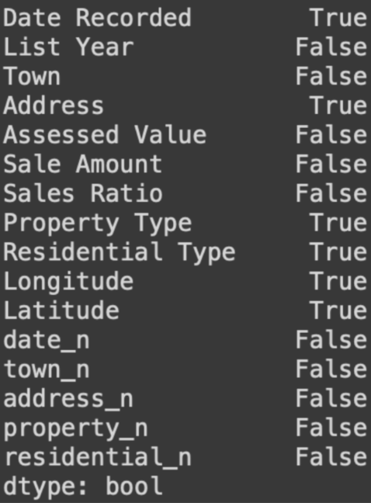
Methodology - Data Preprocessing
Handling Missing Values
Filled missing values in Longitude and Latitude with the mean.
Rechecked and confirmed no remaining missing values.
Normalization
Applied to all numerical and label-encoded features.
Final Features
Date Recorded, List Year, Town, Address, Assessed Value, Sales Ratio, Property Type, Residential Type, Longitude, Latitude.
Target Variable: Sale Amount
Label: Affordable

Slide 8
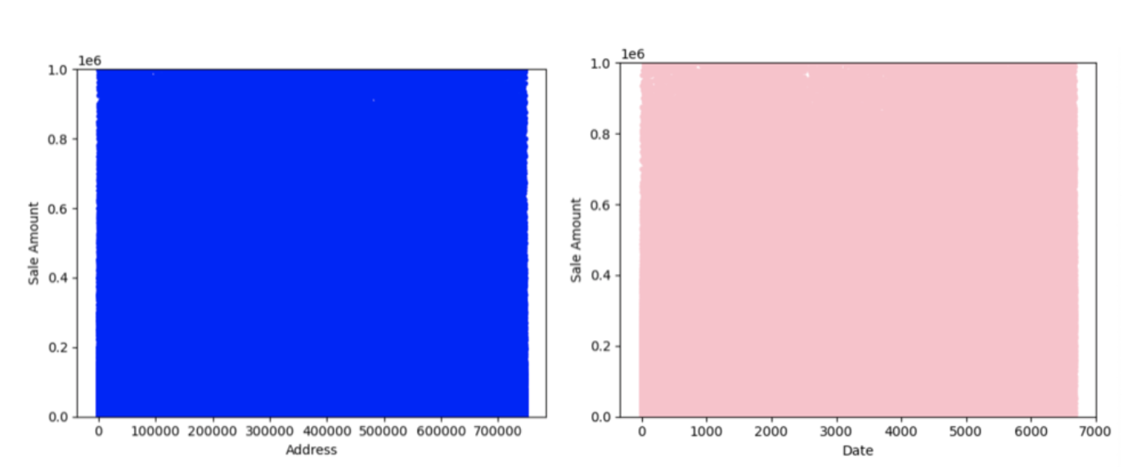
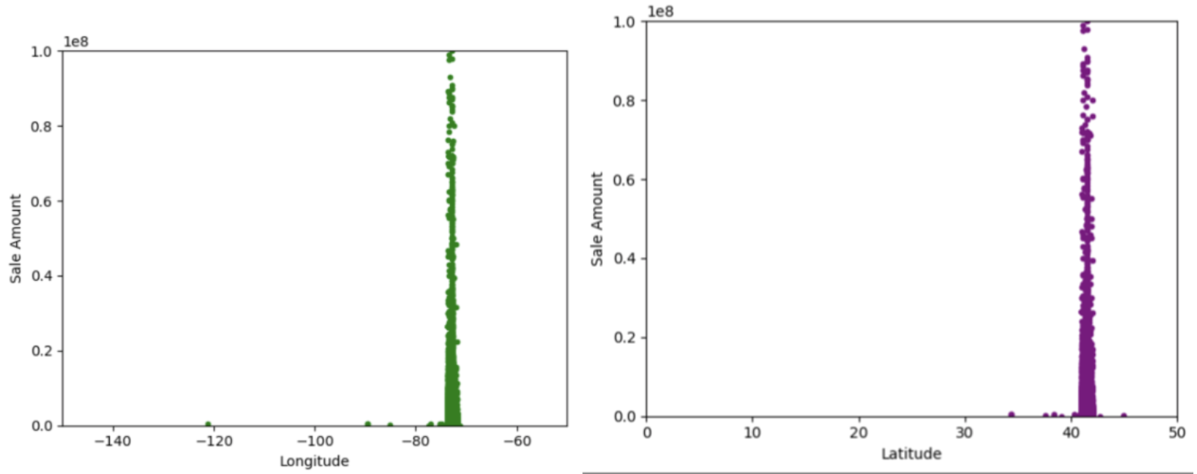
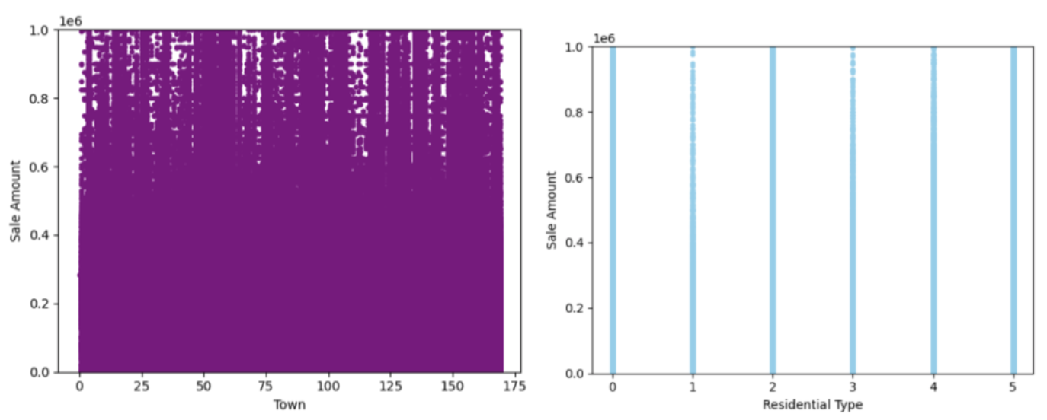
Methodology - Exploratory Data Analysis
Visualization of features that did not have much direct initial significance to the Sale Amount
Residential Type, Longitude,
Latitude
Address,
Date,
Town

Slide 9
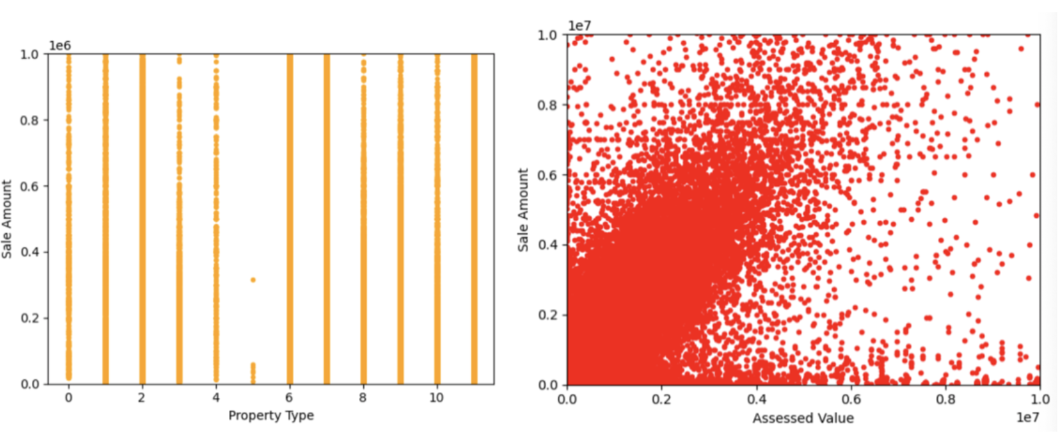
Methodology - Exploratory Data Analysis
Two features that had significance on Sale Amount in the initial run.

Slide 10
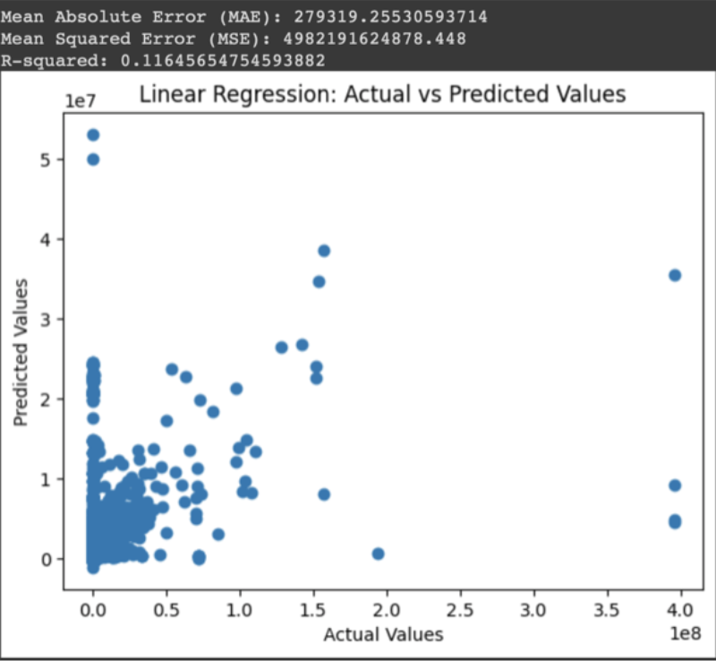
Analysis and Results - Linear Regression
Model Performance: The linear regression model requires significant improvement.
Evaluation Metrics:
Mean Absolute Error (MAE): The model predictions are off by an average of 279,319.25 units.
Mean Squared Error (MSE): Indicates substantial errors in the model's predictions, greater than MAE.
R-Squared: Shows that the model does not fit well with the dataset.
Potential Improvements:
Feature Engineering: Enhance the model by creating new features or modifying existing ones.
Data Issues: Identify and resolve any underlying data issues.
Model Complexity: Adjust the complexity of the linear regression model.

Slide 11
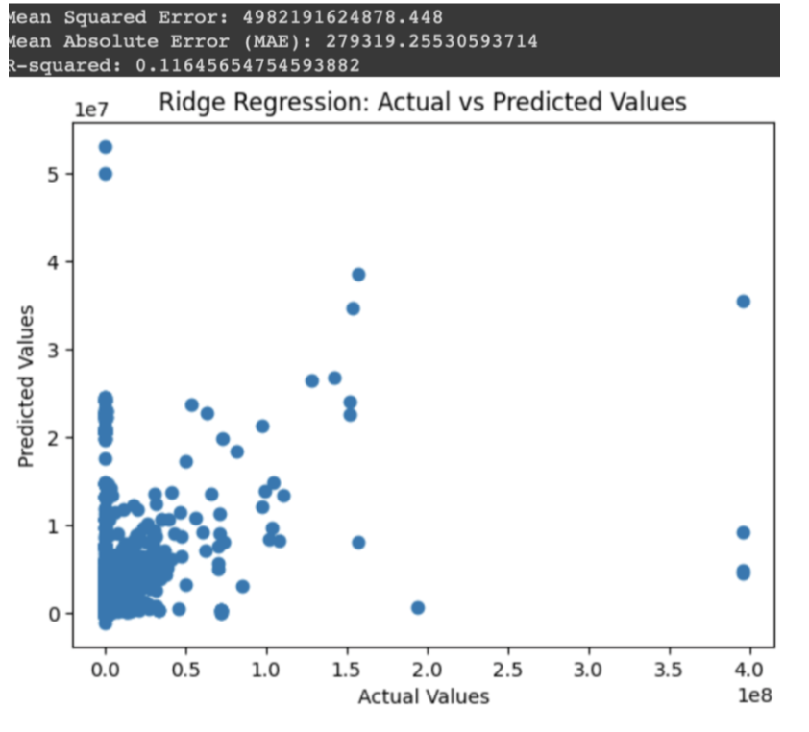
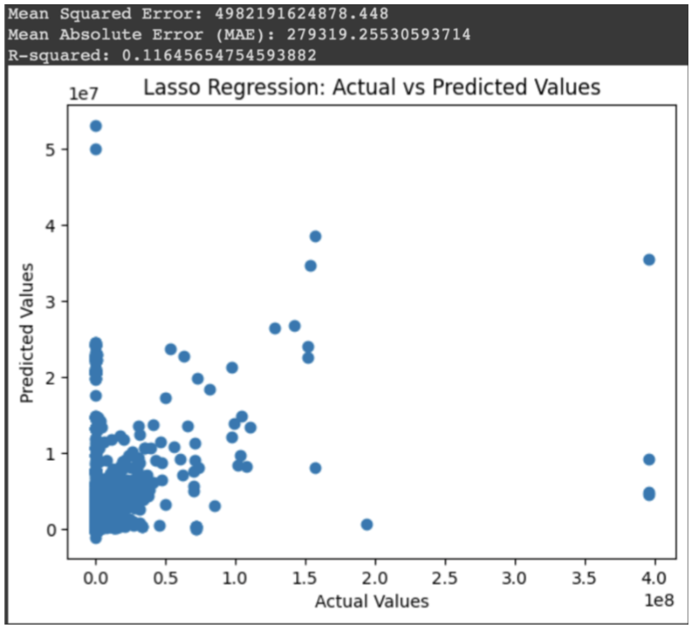
Analysis and Results - Lasso and Ridge Regression
Ridge and Lasso Regression:
Performance: Metrics identical to Linear Regression.
Conclusion: Ridge did not improve model performance.

Slide 12
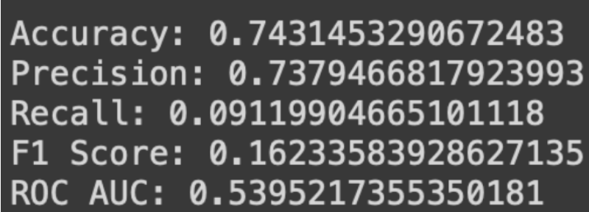
Analysis and Results - Logistic Regression
Accuracy: 74.31% - Indicates the model's overall correctness.
Precision: 73.79% - Proportion of true positives among all positive predictions.
Recall: 9.12% - Model's ability to capture true positive instances.
F1 Score: 16.23% - Reflects the balance between precision and recall, showing poor performance due to dataset imbalance.
ROC AUC: 53.95% - Slightly better than random guessing, indicating the model's limited ability to differentiate between classes.

Slide 13
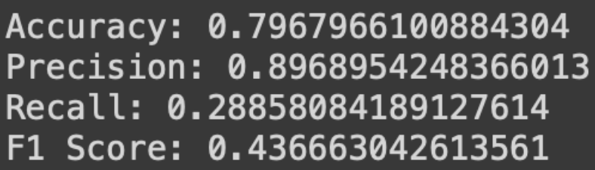
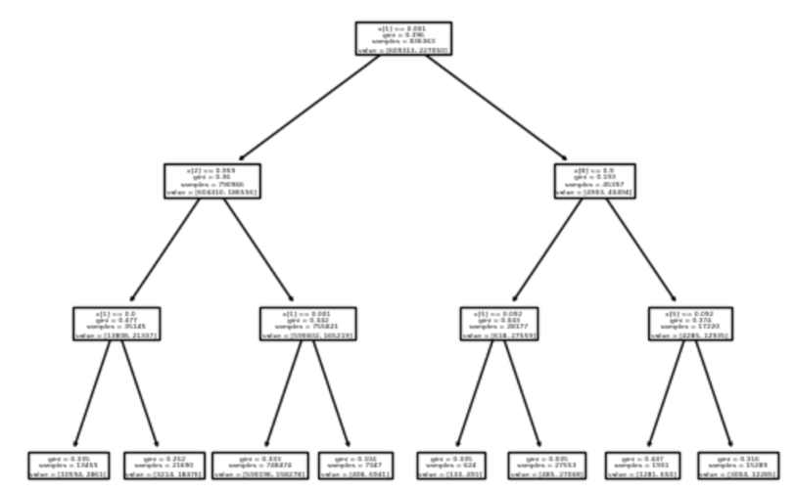
Analysis and Results - Decision Tree Model #1
Performance Metrics
Accuracy & Precision:
High accuracy and precision.
Indicates the model is effective at predicting positive cases when it makes a positive prediction.
Recall & F1 Score:
Low recall and F1 score.
Implication: The model misses a significant number of actual positive instances.
F1 Score: Reflects an imbalance between precision and recall.
Cross-Validation:
Mean Score: ~0.887 with some variability.
Significance: The model performs well and consistently across different data subsets.

Slide 14
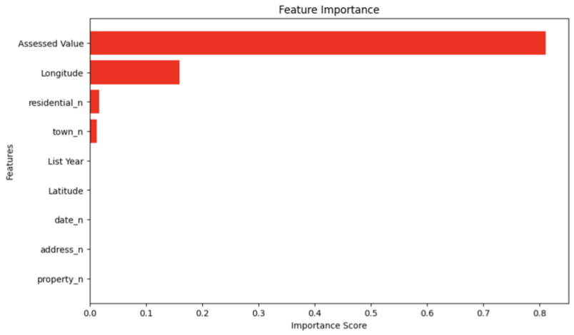
Analysis and Results - Decision Tree Model #1
Performance Metrics
Feature Importance:
Notable finding: Longitude, previously considered insignificant during EDA, shows importance in predicting Sale Amount in this model.
Confusion Matrix:
Strengths: Good at identifying negative instances.
Weaknesses: Misses a substantial number of positive instances.
Overall Accuracy: 80%
Grid Search Cross Validation:
Optimal model configuration achieved.
Final Accuracy: ~81%

Slide 15
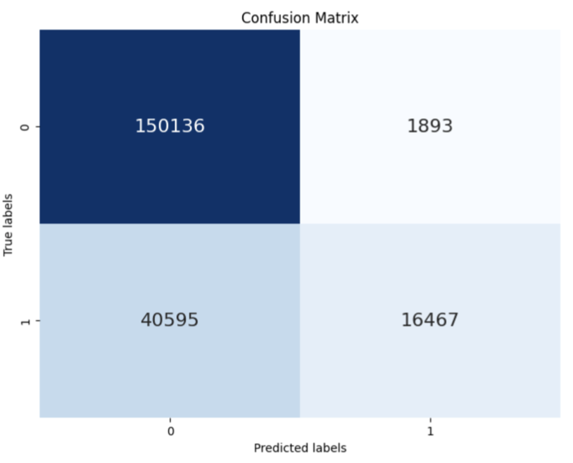
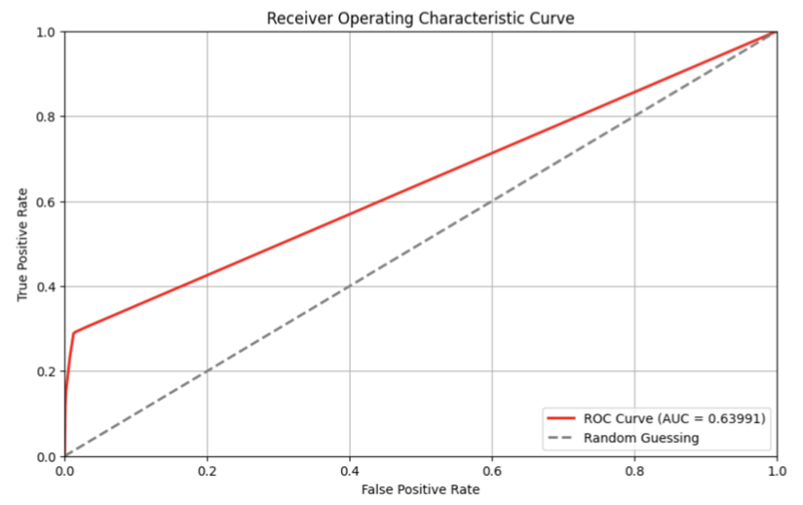
Analysis and Results - Decision Tree Model #1

Slide 16
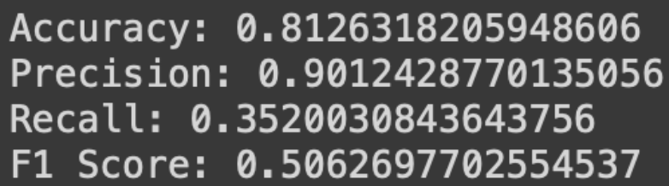
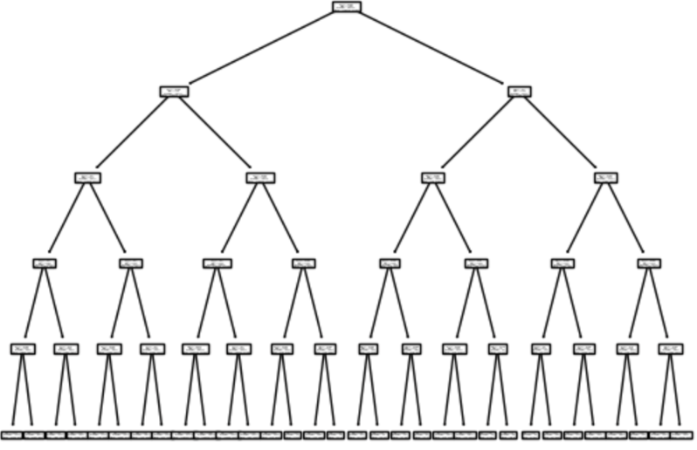
Analysis and Results - Decision Tree Model #2
Model Improvements
Hyperparameter Tuning:
Based on best parameters from Grid Search Cross Validation of Decision Tree Model #1.
Performance Metrics:
Accuracy, Precision, Recall, and F1 Score: All metrics showed significant improvement compared to the first Decision Tree model.
Cross-Validation Scores: Higher mean score with improved consistency across folds.
Implications:
The Grid Search optimization positively impacted model stability and accuracy.
Enhanced performance across all evaluation aspects demonstrates the effectiveness of the selected hyperparameters.

Slide 17
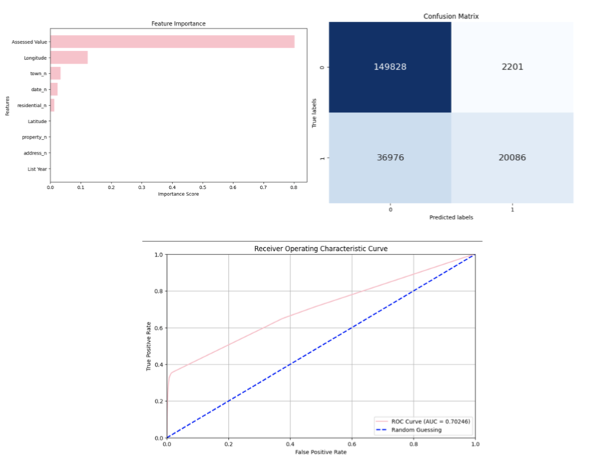
Analysis and Results - Decision Tree Model #2

Slide 18
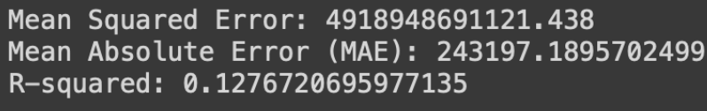
Analysis and Results - Simple Neural Network for Regression
Performance Overview
Loss and Mean Squared Error (MSE):
Training Loss: 4,918,952,853,504.0000
Significance: The extremely high loss and MSE indicate that predictions are significantly off from the actual target values in the training data.
Implications:
Prediction Errors: The model shows substantial errors in its predictions.
Model Fit: The model's fit to the training data is poor, suggesting it is not effectively learning the underlying patterns.
Summary:
The high loss and MSE reflect a model with poor predictive accuracy and significant room for improvement in performance.

Slide 19
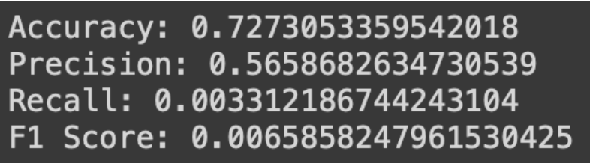
Analysis and Results - Simple Neural Network for Classification
Evaluation: A lot better than the SNN for regression.
The model has a decent overall accuracy. However, it still does poorly on detective positive instances which then led to a low recall and f1 score.

Slide 20
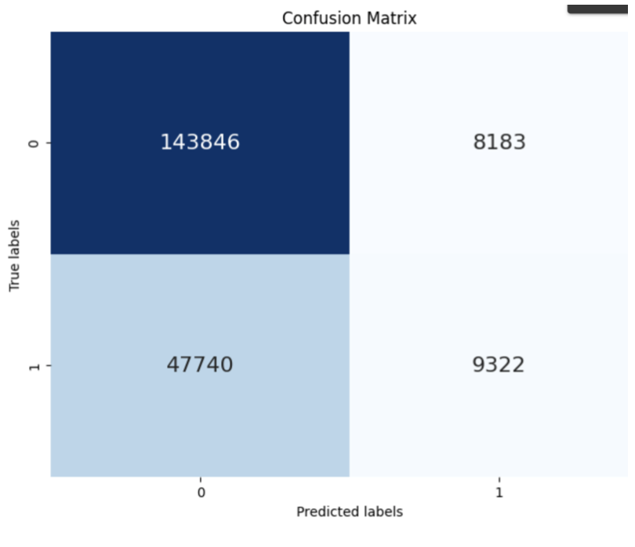
Analysis and Results - Gaussian Naive Bayes
Performance Overview
Strengths:
Performed well for negative classes.
Achieved reasonable overall accuracy.
Challenges:
Struggled with positive classes, leading to:
Low recall for positive classes.
Low F1 score for positive classes.
Limited ability to detect positive classes effectively.
Summary:
While GaussianNB provided acceptable accuracy, its performance was not as optimal in identifying positive instances, impacting its overall effectiveness in the classification task.

Slide 21

Analysis and Results - Support Vector Classifier, K-Nearest Neighbors, and Random Forest Classifier
Support Vector Classifier (SVC)
Attempted Application: SVC was considered for the project.
Challenge: The dataset was too large, leading to excessive computation time.
Outcome: SVC did not complete execution due to long processing time.
K-Nearest Neighbor (KNN)
Attempted Application: KNN was explored as an alternative.
Challenge: High computational expense and significant memory usage.
Outcome: KNN was unable to run effectively due to resource constraints.
Random Forest Classifier
Attempted Application: Random Forest Classifier was also evaluated.
Challenge: Similar issues with computational expense and memory usage.
Outcome: Random Forest Classifier did not execute successfully.

Slide 22
Discussion
Best Performing Model
The second Decision Tree model had the highest evaluation scores and provided significant insights, particularly highlighting the importance of Longitude on Sale Amount, which was not evident during the initial exploratory data analysis.
Regression Models
These had the worst scores, indicating that classification models were more suitable for this dataset.
Methodology Challenges
The process was exhaustive and tedious, requiring individual training and evaluation of each model.
Using the meta-data regression analysis method from the first literature article could have streamlined this process, providing a list of top contenders with a robust SAR metric and reducing computational effort.
Comparison with Second Article
The second article focused on a smaller, cleaner dataset and found Random Forest to be the most accurate classifier.
In contrast, our study involved a much larger dataset with necessary cleaning steps (e.g., handling NaN values, duplicates, and label encoding).
While Random Forest was impractical to train on our larger dataset, the Decision Tree, a simplified version of Random Forest, proved to be the most effective model.

Slide 23
Conclusion
Project Goals
Developed machine learning models to predict house sale amounts and classify properties as affordable or non-affordable.
Key Findings
Effective Model: Decision Tree model outperformed others for both tasks, revealing the significant impact of Longitude on Sale Amount.
Regression Models: Showed lower efficacy, indicating classification approaches were more suitable for the dataset.
Challenges
Managing separate datasets for regression and classification tasks.
Lack of temporal separation in the data, potentially affecting results due to inflation and other time-related factors.
Future Research
Explore temporal segmentation to analyze trends over shorter periods.
Investigate advanced model evaluation techniques like meta-data regression analysis.
Expand the dataset with additional features and geographic regions to better understand real estate market factors

Slide 24
References
[1] T. Doan and J. Kalita, ”Selecting Machine Learning Algorithms Using Regression Models,” 2015 IEEE International Conference on Data Mining Workshop (ICDMW), Atlantic City, NJ, USA, 2015, pp. 1498-1505, doi: 10.1109/ICDMW.2015.43.
[2] C. A. Ul Hassan, M. S. Khan and M. A. Shah, ”Comparison of Machine Learning Algorithms in Data Classification,” 2018 24th International Conference on Automation and Computing (ICAC), Newcastle Upon Tyne, UK, 2018, pp. 1-6, doi: 10.23919/I- ConAC.2018.8748995.
[3] N.Fatema, "DS 5220: Supervised Machine Learning and Learning Theory" Lectures 2024.

Slide 25
Thank You!

